Slide 1
TUITION FEES CROWD-FUNDING SYSTEM USING ARTIFICIAL INTELLIGENCE TO CLASSIFY STUDENTS IN NEED OF FINANCIAL ASSISTANCE
A presentation by Munqitshwa Admire T
B1748059

Slide 2
Background
Financial aid systems from charity organisations such as the higher life foundation from Econet have been around over the past years. These organisations have helped so many students through financial assistance to allow them to have access to education and improve their livelihoods. The distribution of these funds has seemed to be less accessible to everyone and also the old system present has restricted single individuals that do not belong to any organisation to also participate in giving financial assistance

Slide 3
Introduction
Students are dropping out of tertiary yearly because of failure to pay fees due to economic hardships whilst there are well-wishers on the other hand willing to give a helping hand to help those students that are less privileged. And with all this going on, the only thing that is missing is a platform that is convenient and transparent to allow those willing to assist to give a helping hand. This platform eliminates the middle man and thus in a way improves transparency and convenience unlike current scholarships being offered which are processed over a long period of time and also the issue of nepotism within organisations offering these scholarships. The student proposes a system for Tuition fees crowd-funding system using Artificial intelligence to classify students in need of financial assistance at his tertiary institution. If properly done, this can benefit the students and more importantly the economy. Having an educated society comes with many benefits which include economic benefits as a result of having a multiskilled society which can help in improving all the sectors of our economy

Slide 4
Problem Statement
Tertiary fees are now becoming a major challenge for many students around the country and many are dropping out. A huge percentage of Zimbabweans are facing financial challenges and some families that have been hit hard by the economic crisis have resorted to minimizing their expenses by cutting educational expenses. Scholarships are not readily available for grab to all students. Currently available scholarship programs available seem to have bottlenecks when it comes to their distribution. What is lacking is a centralized platform that is accessible to everyone and everywhere for offering financial assistance to students.

Slide 5
Research Objectives
To design and implement a crowd funding system for financial aid in tertiary institutions using artificial intelligence
2. To assess the effectiveness of using Artificial intelligence in crowd funding for provision of financial aid in tertiary institutions

Slide 6
Justification of the system
Having a tuition fees crowd funding system helps to reduce the numbers of student dropping out of university due to increased accessibility and also the incorporation of the Artificial Intelligence increases the accuracy to ensure that the correct people benefit from the system.

Slide 7
Scope
Research and implement a classification algorithm suitable for student profiling into classes in relation to their financial backgrounds.

Slide 8
Literature Review
Artificial intelligence has been applied into crowdfunding in the past through the use of a neural network and natural language processing approach to predict the outcome of crowdfunding start-up pitches using text, speech, and video metadata in 20,188 crowdfunding campaigns on Kickstarter. The study emphasizes the need to understand crowdfunding from an investor’s perspective. Linguistic styles in crowdfunding campaigns that aim to trigger excitement or are aimed at inclusiveness are better predictors of campaign success than firm-level determinants. Consequently, potential backers in crowdfunding are looking for potential cues to reduce uncertainty and predict new venture success when making their capital contributions (Mollick 2013; Ahlers et al. 2015).
Another Application is in Topic Predictions and Optimized Recommendation Mechanism Based on Integrated Topic Modelling and Deep Neural Networks in Crowdfunding Platforms whereby the accelerated growth rate of internet users and its applications, primarily e-business, has accustomed people to write their comments and reviews about the product they received. These reviews are remarkably competent to shape customers’ decisions. However, in crowdfunding, where investors finance innovative ideas in exchange for some rewards or products, the comments of investors are often ignored. These comments can play a markedly significant role in helping crowdfunding platforms to battle against the bitter challenge of fraudulent activities. Taking advantage of language modelling techniques and aiming to merge them with neural networks to identify some hidden discussion patterns in the comments.

Slide 9
Crowdfunding as a Tool
. Today, with the fast development of the computer science and IT, especially the Internet, it is certain that the crowd is connected to the Web. Web 2.0 was defined as “a primarily collaborative web platform where individuals can share their resources” and thanks to that, the crowdfunding can be developed. For the Web 2.0 is a critical instrument that has facilitated the access of the “crowd”.
web-based crowdfunding methods have transformed the ways businesses and foundations raise funds.
Crowdfunding combines the concepts of crowdsourcing and microfinancing, bringing together various individuals who commit small amounts of money to projects, causes or entities they want to support.

Slide 10
Methodology
The researcher used prototype methodology because as it enables to understand customer requirements at an early stage of development.
The researcher decided to use the k nearest neighbour classification method during the course of this research

Slide 11
Requirements Specification
Functional Requirements
Services which the system should provide and how the system should behave in particular situations, the system should be able to:
Categorise students accordingly.
Accommodate interaction of students and donors.
Ensure secure transfer of funds from donors.

Slide 12
Component Diagram

Slide 13
The proposed system above consists of a web application which is the main interface to the system. Both the students and the Donors have to create accounts to be able to interact with system. After logging in the student data is collected from the student profile which he would have completed and also from other secondary sources such as the university repository. On the server-side student data collected is fed to an already trained KNN classification algorithm running on the server for classification. Basing on the training model the algorithm will determine whether the student financial background is either good, average or poor. The classification process will allocate the student profiles priority values depending with the category which they are classified into. Profiles in the category labelled poor will have a much larger priority value compared to those in category average and category good. This prioritisation will work as a screening method to determine which profiles will appear first in line on the donation page.

Slide 14
Research Findings
. In this study, the data set was divided into 70% training data and 30% testing data, then, the labelled features have been selected to apply KNN.
Precision, recall and accuracy of results are measured for the applied algorithm. The accuracy, recall, and precision are used as measurements for the performance of the classifier.
Precision means the proportion of data which is classified correctly. And recall means the percentage of information relevant to the class and its correct classification.
While accuracy is a percentage of instances classified correctly by classifier. A high percentage reflects a strong relation between the features used in training process.

Slide 15
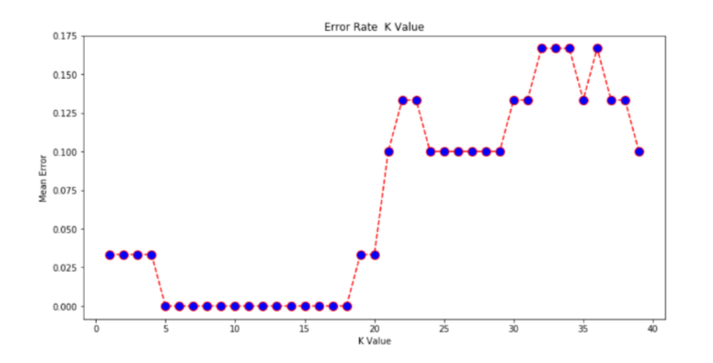
Results
the performance of the naive KNN is quite sensitive to k, the size of the neighbourhood, and it generally favours small k. Using all data sources, naive KNN has prediction accuracy of 75%, 80.5%, 76.2% and 89.9% for k = 5,8, 10,18 respectively.
From the output it can see that the mean error is zero when the value of the K is between 5 and 18. Playing around with the value of K impacts the accuracy of the predictions.

Slide 16
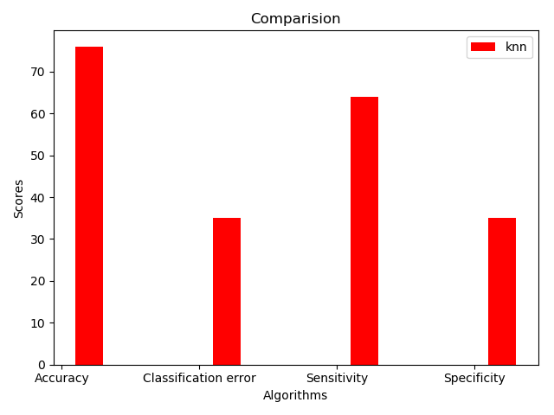
KNN Results

Slide 17
Basing on the results obtained, we can see that the introduction and use of tuition fees crowd funding system can go a long way in assisting students to attain financial assistance more efficiently. Educational databases contain large amounts of data that is increasing rapidly. To understand more about student data, classification algorithms can be applied to the educational datasets.
The study focused on KNN as a major classification algorithm to come up with a student financial background prediction model. In our presented study, KNN algorithm had an accuracy of 89% in classification which means a strong relationship between the student data and their backgrounds.

Slide 18
Future work
This system was implemented using python module which are sklearn, pandas and numpy which offer frameworks for data classification taking advantage of the CPU of the machine only. However, such system can be implemented using some other algorithms such as the naïve bayes classification algorithm or the neural networks which take advantage of both the CPU and the GPU of the PC.

Slide 19
Challenges faced
Many researchers have encountered problems that are prone to data classification systems, in the implementation of this system the researcher also encountered some challenges. The system was affected by the quality of the data obtained and for this matter the classification results were affected in some cases.

Slide 20
Recommendations
The implemented system can classify vast amounts of student data into categories which allow us to determine their financial backgrounds. The system was implemented taking advantage of the capabilities of the KNN algorithm .The classification accuracy obtained after the tests shows that the algorithm can be used in other several real time environments which work with data classification.

Slide 21
Conclusion
funding system was developed and implemented successfully and could perform the desired functionalities. A lot was learnt by the researcher during the course of this research.

